Slide 1
Customer Booking Prediction
By V YUVAN KRISHNAN

Slide 2
Task Brief
Objective:
Predict customer booking behavior using machine learning.
Steps Taken:
Dataset exploration and preparation.
Model training using Random Forest.
Model evaluation and visualization.
Findings and actionable insights.
Tools Used: Python (pandas, scikit-learn, matplotlib, seaborn).

Slide 3
Dataset Exploration
Dataset Details:
Rows: 50001
Columns: Key features like . num_passengers sales_channel trip_type purchase_lead , etc.
Key Findings:
Dataset contained categorical and numerical variables.
Some missing values were handled appropriately.
Data Cleaning and Preparation:
Encoded categorical variables using OneHotEncoder.
Scaled numerical features for better model performance.

Slide 4
Model Training
Model Used: Random Forest Classifier and XGBoost
Why Random Forest?
Handles both categorical and numerical data efficiently.
Provides feature importance for interpretability.
Why XGBoost?
Model Hyperparameters:
Number of Trees: n_estimators=100
Max Depth: Optimized
Random State: 42
Highly accurate and fast, with regularization to avoid overfitting.
Best suited for structured/tabular data.
An efficient implementation of gradient boosting.

Slide 5
Model Training
Training Process:
RandomForest:
Trained a RandomForest classifier.
Optimized hyperparameters using GridSearchCV.
XGBoost:
Trained an XGBoost classifier.
Tuned parameters such as learning rate, max depth, and n_estimators.

Slide 6
Model Evaluation
RandomForest Evaluation:
Cross-Validation Accuracy Scores:
[0.84575, 0.84325, 0.842875, 0.84225, 0.84825]
Mean Accuracy: 0.844475
Standard Deviation: 0.0022
RandomForest Classification Report:
Accuracy: 0.85
Precision: 0.87 (Class 0), 0.45 (Class 1)
Recall: 0.97 (Class 0), 0.14 (Class 1)
F1-Score: 0.92 (Class 0), 0.21 (Class 1)
Confusion Matrix:
[[8275, 245], [1277, 203]]

Slide 7
XGBoost Evaluation
XGBoost Evaluation:
XGBoost Cross-Validation Accuracy:
Mean Accuracy: 0.8482
Standard Deviation: 0.0005
Classification Report:
Similar structure to RandomForest, but with potential improvements in Class 1 performance.
Confusion Matrix:
Similar to the one from RandomForest, with expected improvements in Class 1 performance due to better handling of imbalanced data.

Slide 8
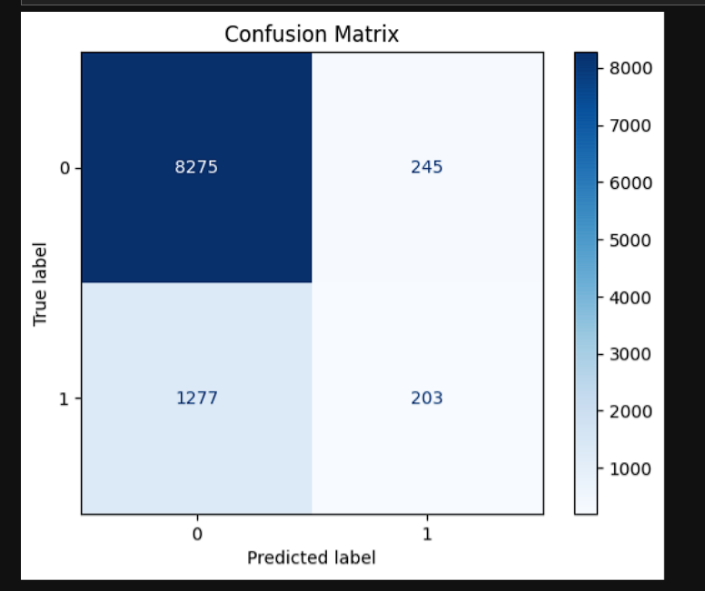
Confusion Matrix

Slide 9
Feature Importance Visualization
Feature Importance:
Visualized the importance of various features in predicting customer booking.
Key features identified using both RandomForest and XGBoost.
Both models highlighted the importance of certain booking-related features.

Slide 10
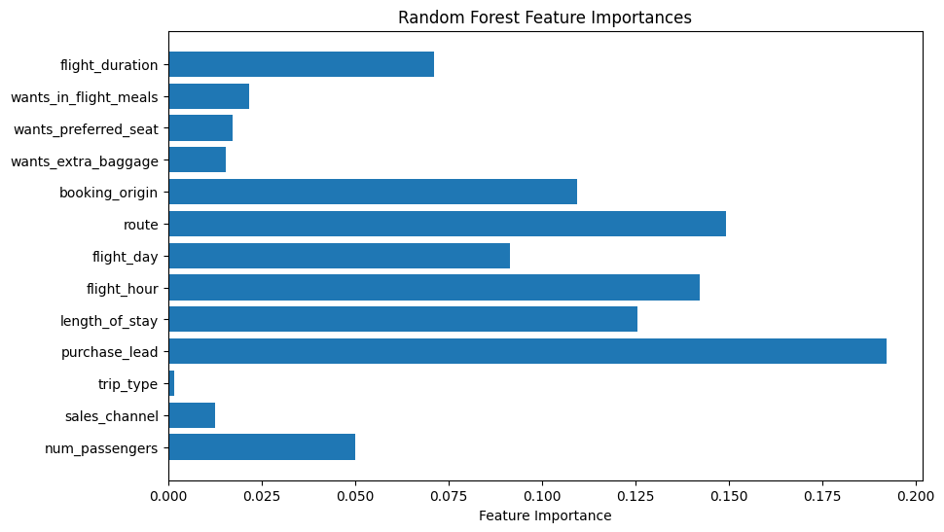
Random Forest Feature Importances

Slide 11
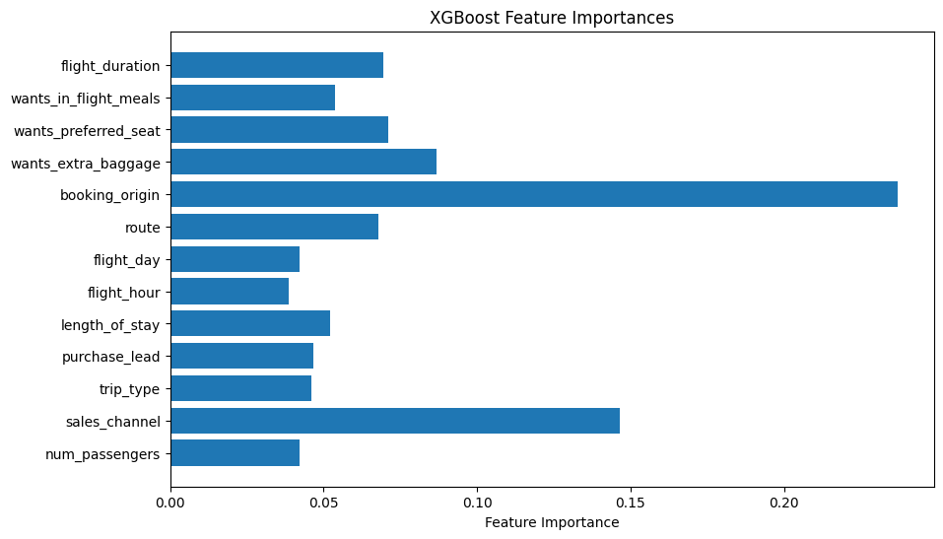
XGBoost Feature Importances

Slide 12
Final Findings and Recommendations
Summary of Findings:
RandomForest: High accuracy but with lower performance in predicting Class 1 (booking made).
XGBoost: Achieved slightly better accuracy with improved handling of imbalanced classes.
Recommendations: Consider further tuning of models and possibly balancing the dataset to improve Class 1 prediction.

Slide 13
Conclusion
Both RandomForest and XGBoost are powerful tools for predictive modeling, offering robust performance with the ability to handle large and complex datasets. RandomForest excels in feature importance interpretation, while XGBoost shines in terms of handling missing data and managing class imbalances with its gradient boosting approach. However, fine-tuning and addressing data imbalance are key to improving the model's predictive performance, especially for Class 1 (booking made) outcomes, where recall and F1-score need significant improvement. Techniques like oversampling (e.g., SMOTE), class weighting, or using more sophisticated algorithms like balanced random forests could be explored to enhance the model’s sensitivity towards the minority class. Additionally, hyperparameter optimization, such as tuning the learning rate, tree depth, or regularization terms, will likely increase both accuracy and generalizability. By refining these aspects, we can build a more balanced and high-performing predictive model.

Slide 14


